Slide 1

Efficienza della laparoscopia:
è ancora giustificato il passaggio al robot nella sleeve primaria?
Enrico Facchiano
Emanuele Soricelli
S.O.C. Chirurgia Generale, Metabolica e Bariatrica
Ospedale Santa Maria Nuova – Firenze
S.O.S. Chirurgia Metabolica e Bariatrica
Ospedale San Jacopo – Pistoia
Notes:
1

Slide 2
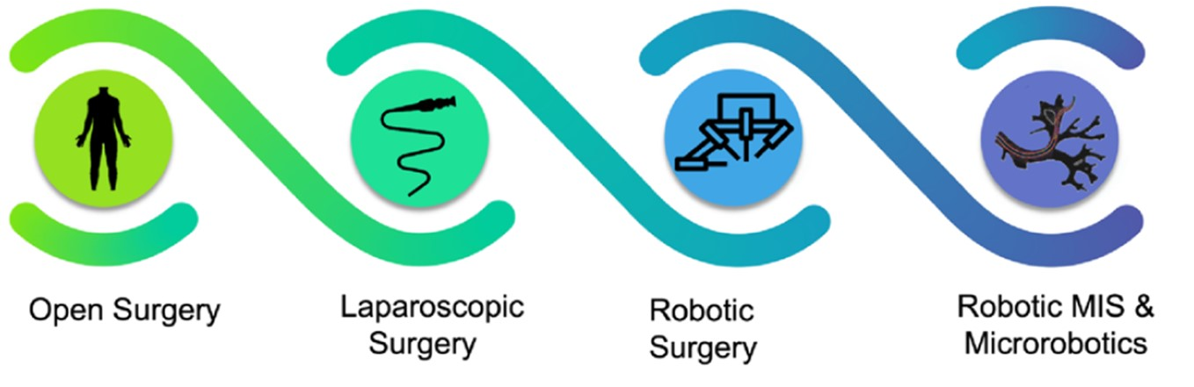
Notes:
In questi anni stiamo assistendo ad una vera e propria transizione tecnologica con il passaggio dall’approccio laparoscopico alla piattaforma robotica

Slide 3
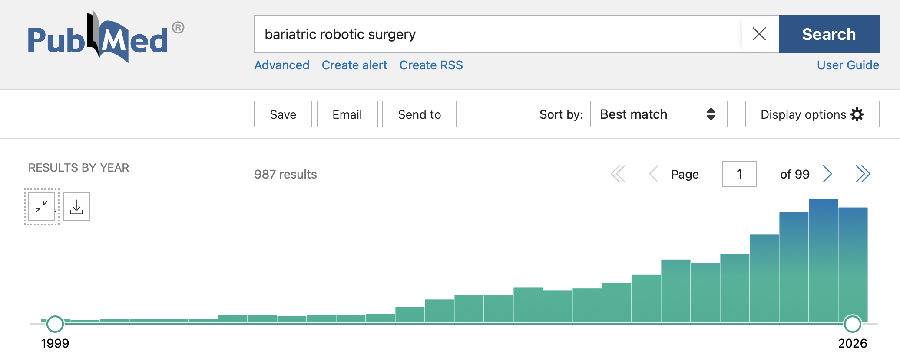
Scientific production on robotic metabolic and bariatric surgery
160
149

Slide 4
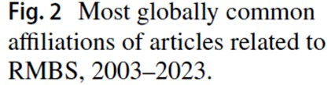
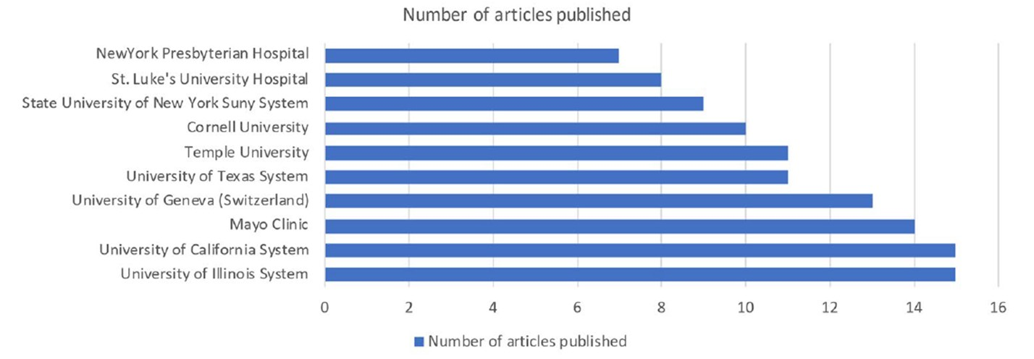
Scientific production on robotic metabolic and bariatric surgery
Rivero-Moreno, J Robotic Surg 2024

Slide 5
There is no doubt that robotic surgery is here to stay
Papasavas et al. Editorial comment SOARD 2024
Notes:
Siamo di fronte ad una rivoluzione chirurgica epocale cominciata già da alcuni anni

Slide 6
Primary sleeve gastrectomy is already a highly efficient laparoscopic procedure
STANDARDIZATION
LEARNING CURVE
BENEFIT THRESHOLD
Access, exposure, gastric mobilization, stapling and hemostatic control are highly reproducible.
Laparoscopy allows high-volume practice, short operative times and an established workflow.
To replace an efficient technique, robotics must improve clinically meaningful outcomes—not only ergonomics.
Principle: “non-inferior” does not automatically mean “better.”
2

Slide 7
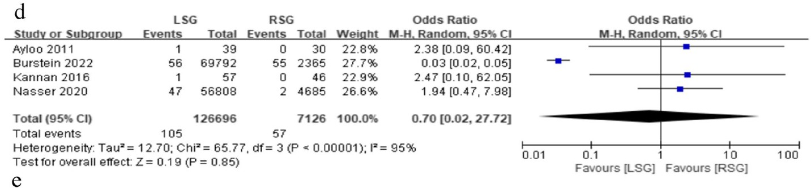
Conversion rate
No difference

Slide 8
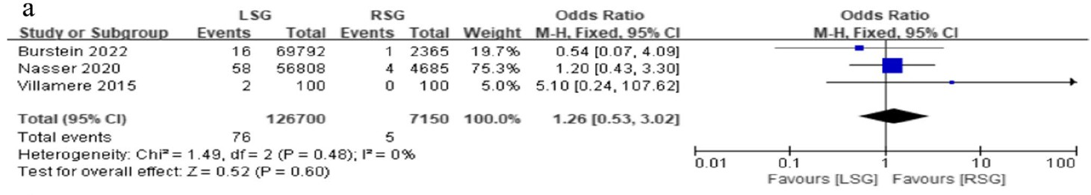
Mortality
No difference

Slide 9
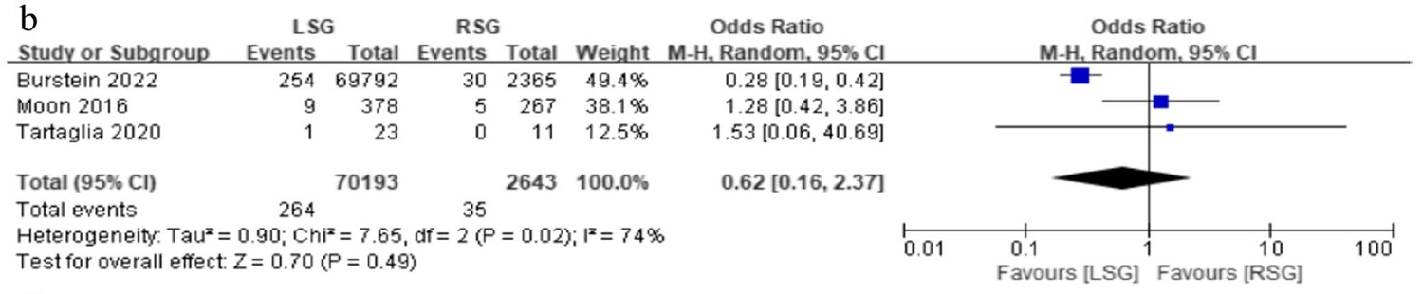
Staple line leak
No difference

Slide 10
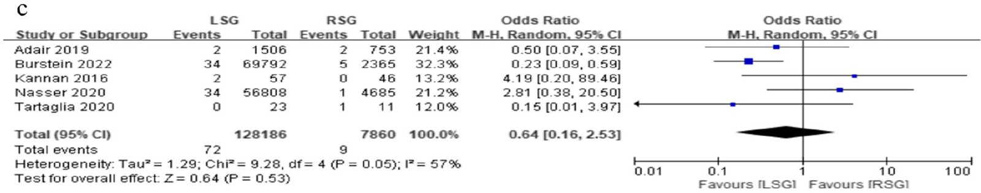
Surgical site infection
No difference

Slide 11
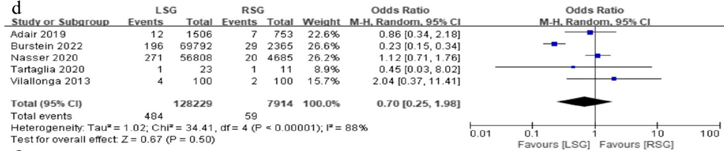
Bleeding
No difference

Slide 12
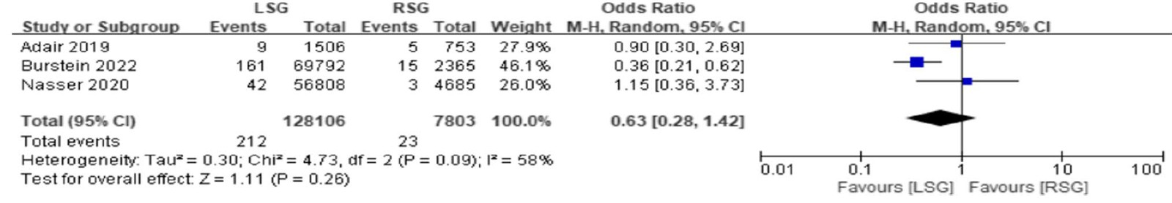
Incisional hernia
No difference

Slide 13
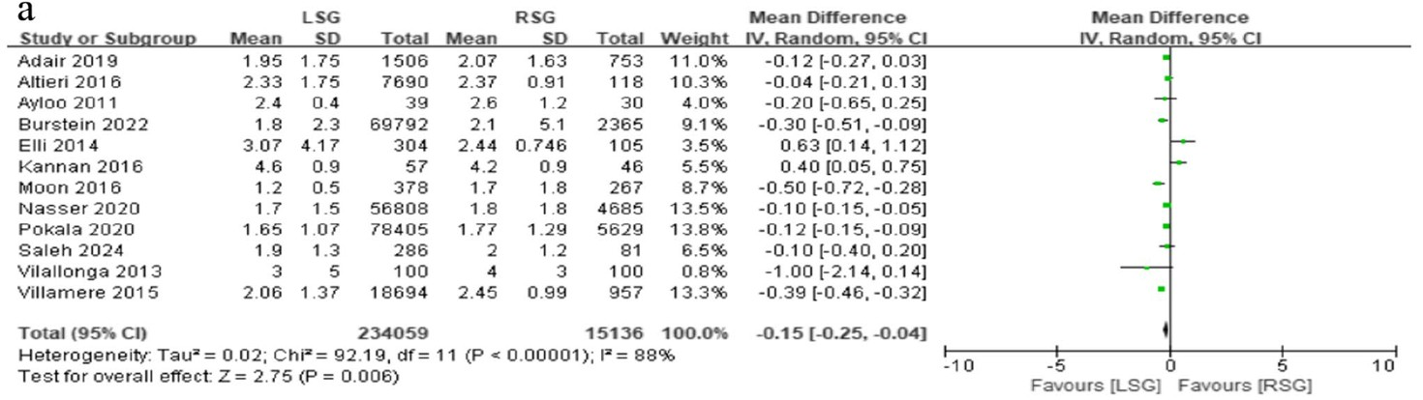
Length of hospital stay
Favours laparoscopy

Slide 14
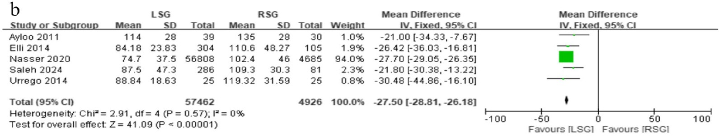
Operative time
Favours laparoscopy

Slide 15
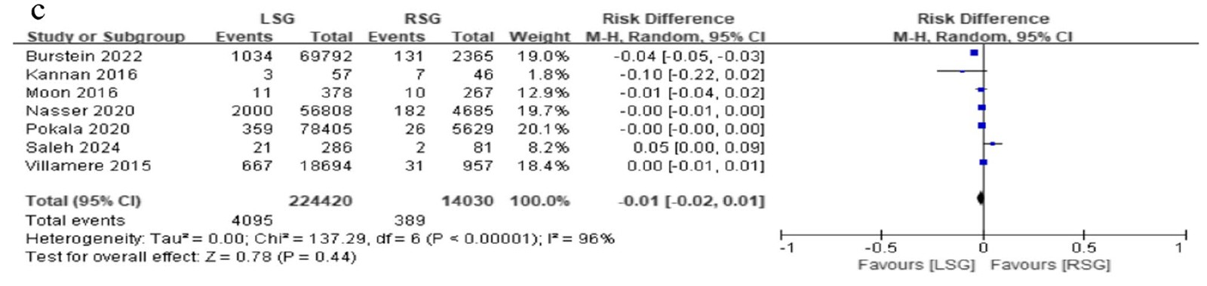
Readmission rate
Favours laparoscopy

Slide 16
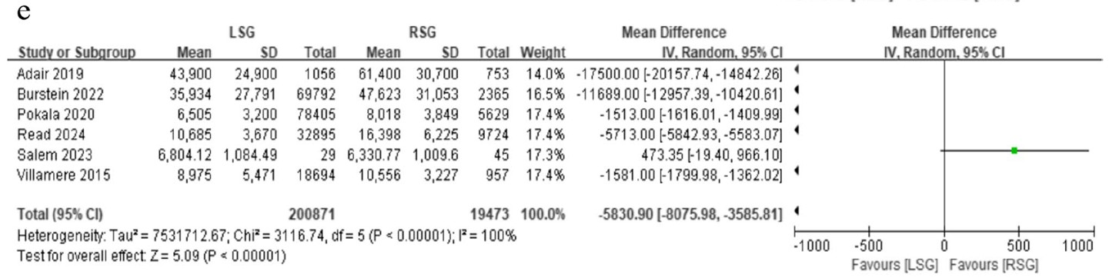
Charges
Favours laparoscopy

Slide 17
The issue is efficiency
Reported differences favoring laparoscopy
For a high-volume procedure,
a marginal difference per case multiplies across annual volume.
Operative time
+27.5 min
Length of stay
+0.15 days
Hospital cost
+US$5,831
When two techniques are clinically equivalent, time and cost become outcomes
Zhao et al. Obes Surg 2024
4

Slide 18
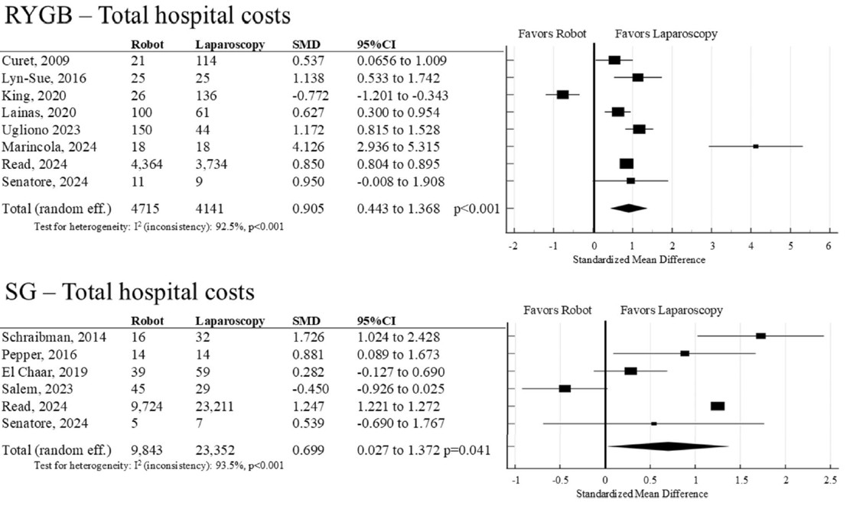

Slide 19
Cost: not only the price of the platform
CAPEX (CApital EXpenditure)
OPEX (OPerating EXpenditure)
OR TIME
Purchase / leasing, maintenance, infrastructure
Dedicated instruments and per-procedure costs
Docking, setup, turnover, learning curve
VOLUME
SURGICAL MIX
SYSTEM ECONOMICS
The higher the volume, the greater the cumulative differential
Value increases when the platform is used for complex cases
Robotics makes more sense when it improves the entire portfolio, not a single sleeve
9

Slide 20
One of the weak point: sleeve gastrectomy requires little suturing
What do we actually do in primary sleeve?
ROBOTICS
• Exposure and traction
• Greater-curvature mobilization
• Stapling line
• Hemostatic control
• Optional testing / revision of the staple line
maximum advantage when the procedure requires
precision + dissection + suturing
In a standard sleeve: only part of the robotic advantage is used.
7

Slide 21
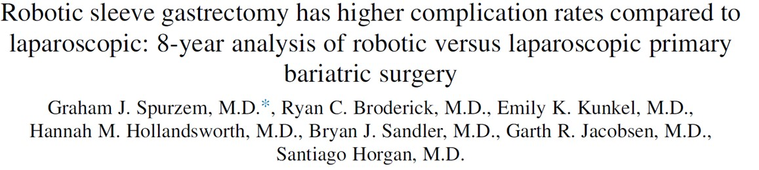
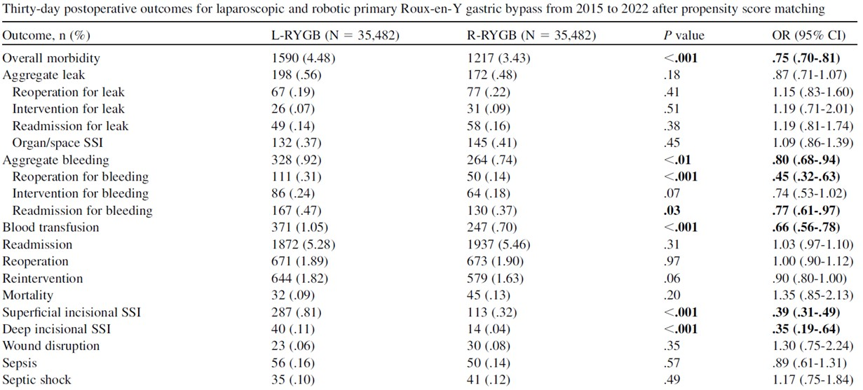
Data from
MBSAQIP
Notes:
Il titolo è perentorio. L’articolo è sulle procedure primarie, ve lo mostro perché il messaggio che passa è che il robot ha un vero vantaggio nelle procedure più complesse, mentre complica quelle più semplici

Slide 22
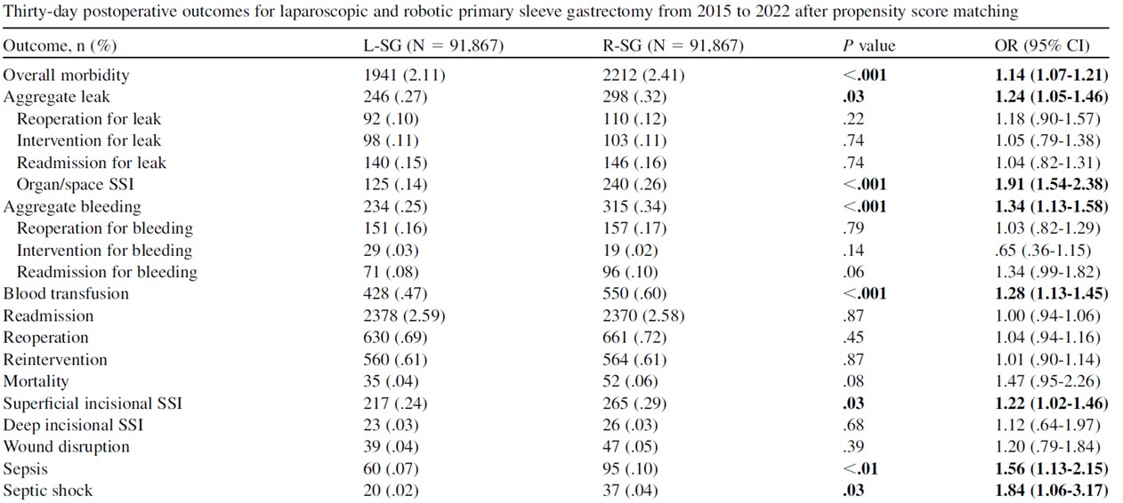
Data from
MBSAQIP
Notes:
Il titolo è perentorio. L’articolo è sulle procedure primarie, ve lo mostro perché il messaggio che passa è che il robot ha un vero vantaggio nelle procedure più complesse, mentre complica quelle più semplici

Slide 23
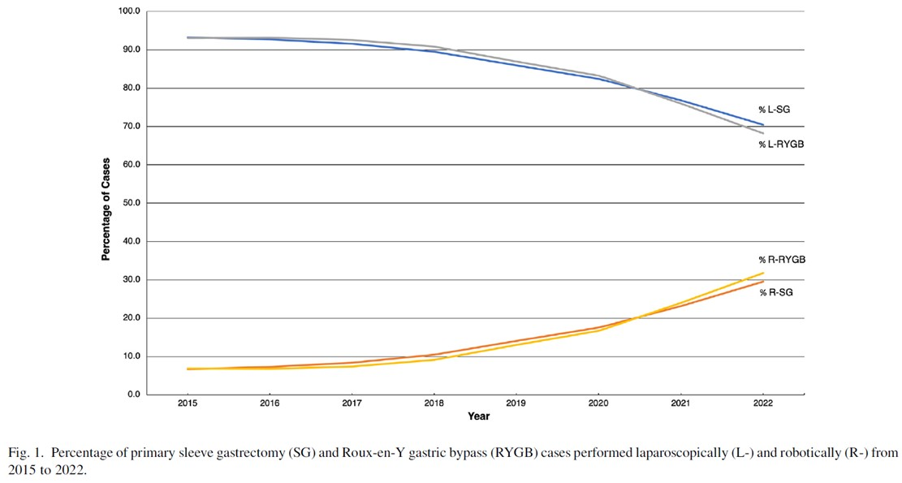
Data from
MBSAQIP
Notes:
Facciamo un passo indietro, andiamo a paragonare due differenti interventi, uno più semplice e uno più complesso. Non ci sono dati del genere per la chirurgia di revisione, per cui proveremo ad estrapolare i dati ed estenderli al nostro topic. Il titolo è perentorio. L’articolo è sulle procedure primarie, ve lo mostro perché il messaggio che passa è che il robot ha un vero vantaggio nelle procedure più complesse, mentre complica quelle più semplici

Slide 24
A practical proposal: select, don’t convert
Robotics in primary sleeve as a strategic choice
1
2
3
4
Standard sleeve
Expected complexity
Mature robotic team
Education
LSG as default
Consider RSG
Assess outcomes and time
SG may represent a suitable procedure for gaining experience with robotic surgery
The goal is to achieve measurable benefit—
not simply to “perform the sleeve robotically.”
11

Slide 25

Future directions
AI
Fluorescence
Navigation
Notes:
Tra i vantaggi non quantificabili c’è un investimento culturale e formativo per il chirurgo nell’ottica di un maggiore utilizzo del robot in futuro

Slide 26
Conclusions
For standard primary sleeve gastrectomy, laparoscopy remains the benchmark
Operative time and cost remain two of the main issues of robotic primary sleeve gastrectomy.
Based on the currently available evidence, the more complex the procedure, the greater the potential advantage of the robotic approach over conventional laparoscopy (e.g., revisional procedures and surgery in super-obese patients).
As robotics is likely to play an increasingly important role in the future, its adoption should also be regarded as a cultural and educational investment for surgeons and SG may represent a suitable procedure for gaining experience with robotic surgery.
Notes:
L’ultima è una considerazione filosofica

Slide 27

Thank you for your attention

